Slide 1
Global Warming
The Negative Effects on our Environment
Presented by Heather Laputka

Slide 2
YouTube.com - Global Warming
Increased global average temperature
Dangers for Certain Areas
Change in Precipitation

Slide 3
Increased Global Average Temperature:
The Main & Most Detrimental Effect
Past 100 years:
0.98 – 1.62
After 2100:
Average Global Temperature will continue to rise
By the year 2100:
2.o – 11.5
According to Michelle LaRowe: ehow.com

Slide 4
Areas of:
Frequent Drought
Frequent Flooding
Poverty
Have an Increased Danger

Slide 5
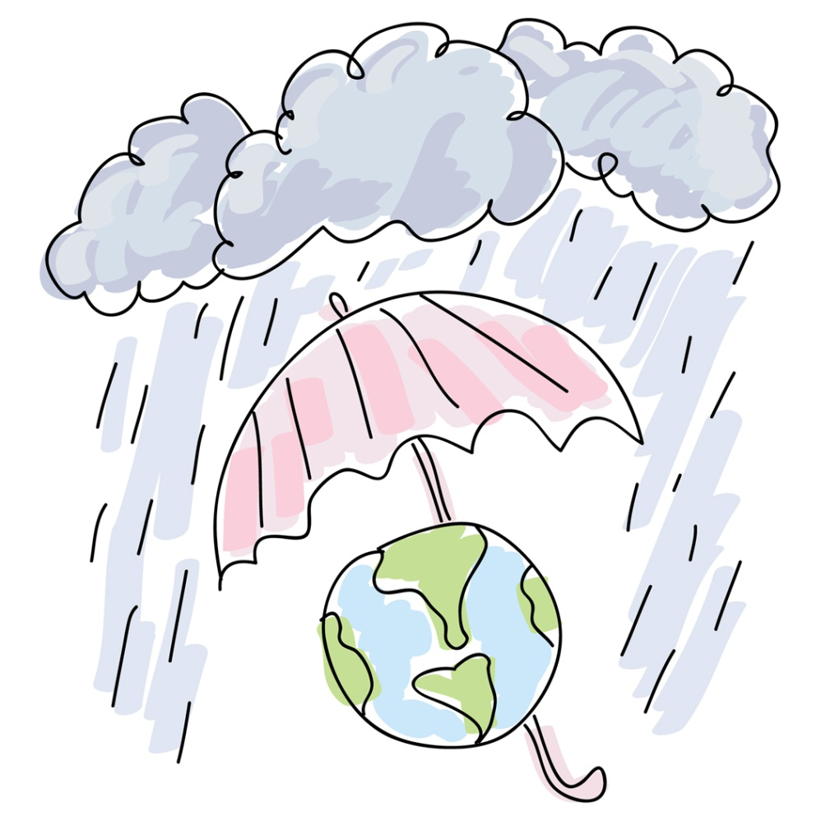
Change in Climate
& Precipitation
Making our Earth uncomfortable to live on.

Slide 6
“ Many People don’t realize that we are committed right now to a significant amount of global warming and sea level rise…the longer we wait to do something about it, the more change we will have.”
-Gerald Meehl, The National Center for Atmospheric Research

Slide 7
Global Warming. Narr. Leonardo Decaprio. YouTube. 19 July. 2006. <http://www.youtube.com/watch?v=C3pujlkSTgo>.
LaRowe, Michelle. About the Negative Effects of Global Warming. Date Accessed: 14 September. 2009. <http://www.ehow.com/about_4567296_negative-effects-global-warming.html>.
Seamon, Greg. Global Warming/Climate Change: What Can We Do About It?. 3 March. 2009. Date Accessed: 14 September. 2009. <http://www.eartheasy.com/blog/2009/03/global-warming-climate-change-what-we-can-do-about-it/>.
What is G8?. Date Accessed: 17 September. 2009. <http://library.thinkquest.org/05aug/01746/IT_wt%20is%20G8.htm>.
Wong, Bryan. Negative Effects of Global Warming. 8 May. 2007. Date Accessed: 14 September. 2009. <http://ezinearticles.com/?Negative-Effects-of-Global-Warming&id=557033>.
Sources:

