Slide 1
Global Warming
What We Need To Do To Reduce and Prevent It
Presented by Heather Laputka

Slide 2
Reduce the Neagtive Effects
Of Global Warming
The Important Role Human Beings Play
What Can be Done Around the Home
What Can be Done Outside of the Home

Slide 3
The important role human beings play in reducing global warming’s negative effects
Emissions of greenhouse gases causes the Greenhouse Effect
Make
Choices
To Reduce
Greenhouse
Gas Output
This will reduce or reverse Global warming

Slide 4
What can be done around the home
Reduce the use of Electricity
Conserve Energy

Slide 5
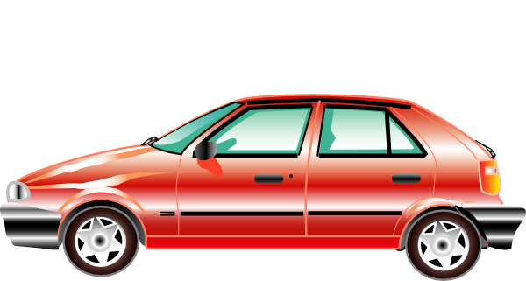
What can be done outside of the home
Improve Fuel Efficiency
Recycle

Slide 6
Recap:
The Important Role Human Beings Play
What Can be Done Around the Home
What Can be Done Outside of the Home

Slide 7
“ Making energy conservation a part of our daily awareness is essential to the goal of reducing global warming.”
-Gerald Meehl, The National Center for Atmospheric Research

Slide 8
LA Daddy. Going Green: A Few Tips to Help Save Our Planet. 19 July. 2007. Date Accessed: 14 September. 2009. <http://www.ladaddy.com/?p=300>
LaRowe, Michelle. About the Negative Effects of Global Warming. Date Accessed: 14 September. 2009. <http://www.ehow.com/about_4567296_negative-effects-global-warming.html>.
Seamon, Greg. Global Warming/Climate Change: What Can We Do About It?. 3 March. 2009. Date Accessed: 14 September. 2009. <http://www.eartheasy.com/blog/2009/03/global-warming-climate-change-what-we-can-do-about-it/>.
Sources:

